Slide 1

Tata CLiQ Product Analytics
Rajula Shravya
Batch : 543

Slide 2
About Me:
B-Tech(Computer Science and Engineering)
Passed out Year: 2026
Learning the data analysts to work with raw data to solve the real-word business problems.
LinkedIn: www.linkedin.com/in/shravya-rajula-a22a5
GitHub: https://github.com/shravyarajula24-gif/Rajula-Shravya.git

Slide 3
Agenda
Introduction
Business Problem
Business Statement
Data description
Data cleaning
Analysis and Insights
Testing
Recommendations
Conclusion
Q&A Slide

Slide 4
Introduction:
Tata CLiQ is an Indian e-commerce platform that offers a wide range of products across categories such as fashion, footwear, beauty, electronics, and lifestyle.
The platform provides products from multiple brands, with variations in price, discounts, ratings, and customer reviews.
In this project, product data was collected from the Tata CLiQ website using web scraping techniques.
The collected data includes important attributes such as Brand, Product, Price, Original Price, Discount, Rating, Reviews, and Product Link.

Slide 5
Business Problem:
Tata CLiQ offers a wide range of products across different brands and categories, making product-level analysis challenging.
Product prices and discounts vary significantly, creating a need to understand pricing and discount patterns.
Ratings and customer reviews differ across products and can indicate customer interest and product performance.
Analyzing these factors can help identify meaningful patterns and trends for better business decision-making.

Slide 6
Business Statement:
To collect and analyze Tata CLiQ product data using web scraping techniques.
To study key attributes such as brand, product, price, original price, discount, rating, and customer reviews.
To identify patterns and relationships between pricing, discounts, ratings, and customer reviews.
To use data-driven and statistical analysis to generate meaningful insights for better business decisions.

Slide 7
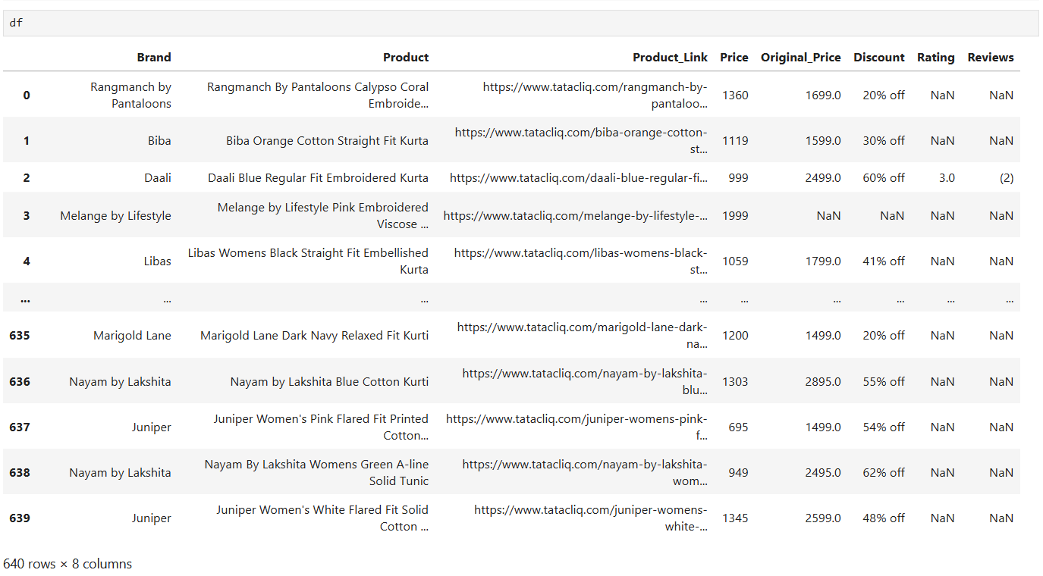
Data Description:

Slide 8
Data Cleaning:
Missing Values: Identified missing values in the collected product data and handled them appropriately.
Duplicate Records: Checked for duplicate product records and removed duplicates where necessary.
Data Type Conversion: Converted numerical columns, such as Price, Original Price, Discount, Rating, and Reviews, into appropriate data types for analysis.
Data Formatting: Cleaned price and discount values by removing unnecessary symbols and formatting inconsistencies.
Final Dataset: Prepared a structured dataset containing 640 product records and 8 columns for further analysis.

Slide 9
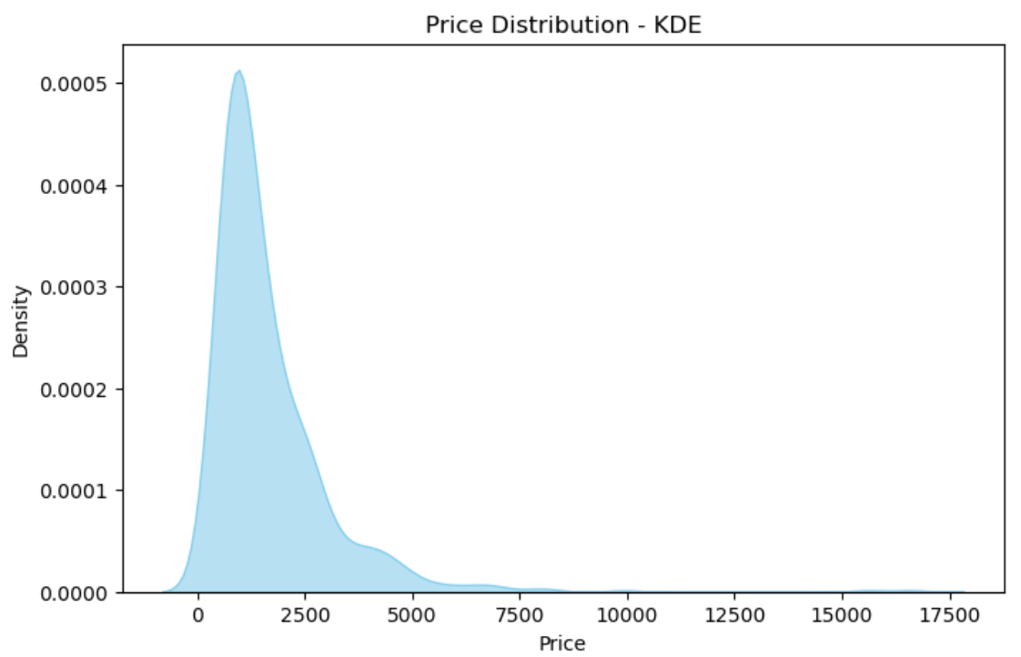
Analysis:
Univariate Analysis:
What is the price distribution of Tata CLiQ products?
Right-Skewed: 85% products in 500-2000 range.
Tata CLiQ focuses on affordable to mid-range segment.

Slide 10
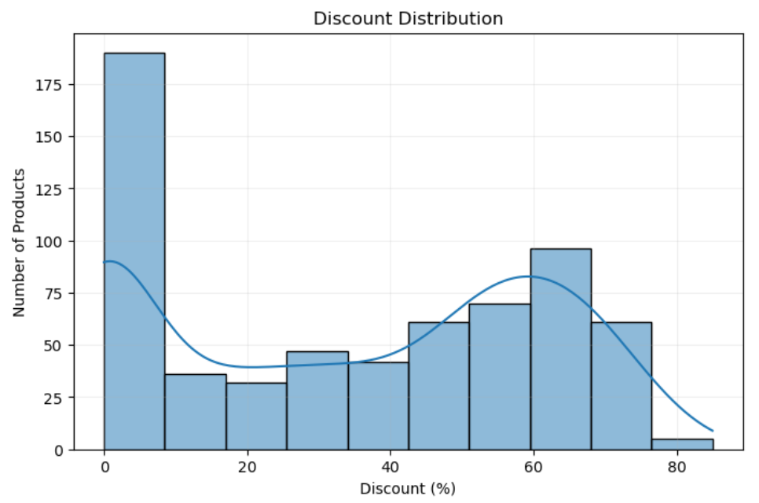
Analysis:
Univariate Analysis:
Which discount range is most frequent?
Most Frequent: 0-10% with 190 products (Full-price strategy)
Second Peak: 60-65% with ∼96 products (Clearance strategy)
Least Frequent: 80%+ with only 5 products
Shows 2 pricing strategies: Premium (0% discount) and Sale (60%+ discount)

Slide 11
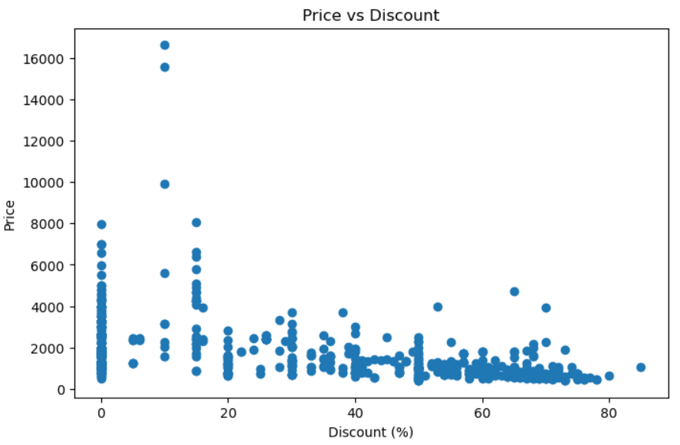
Analysis:
Bivariate Analysis:
What is the relationship between Price and Discount?
No linear relationship - Scattered dots
At 0% discount: Price = 500 to 8000 Rs (High spread)
At 70-80% discount: Price = 500 to 2000 Rs only (Low spread)
Premium products >8000 never go beyond 20% discount
Correlation: Weak negative, Discount is decided by Brand/Season, not Price

Slide 12
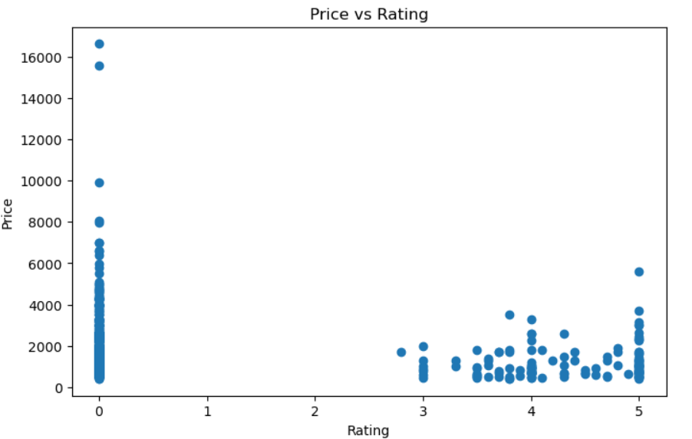
Analysis:
Bivariate Analysis:
What is the relationship between Price and Rating?
Two clusters: 0 rating (400-16.5k, unrated) and 3-5 rating (400-5.6k)
No correlation 0.08 - Same price has different ratings
60% products unrated, all premium >8k are unrated = Need review strategy

Slide 13
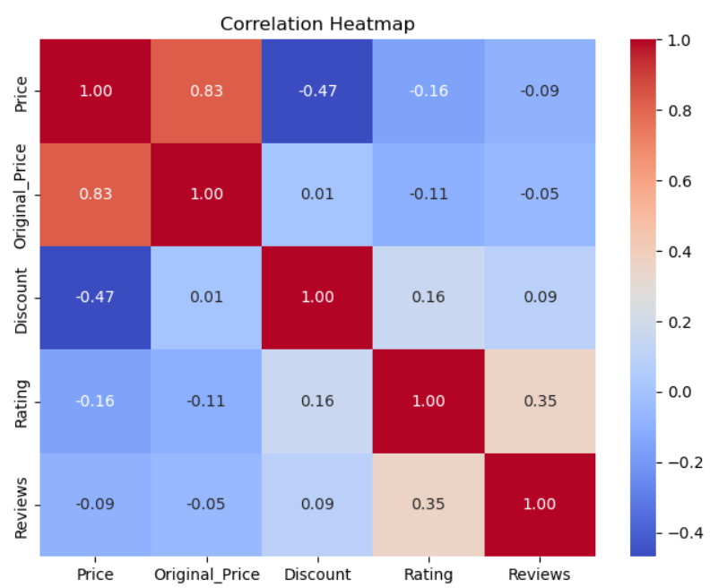
Analysis:
Multivariate Analysis:
What is the correlation among numeric columns?
Strong Positive: price highly depends on original MRP, as expected.
Negative: price decreases moderately.
Weak or No Relation: Rating, Discount almost independent of price, proves discount is brand-driven not price-driven.
Moderate: More reviews depends slightly higher or more stable rating.

Slide 14
Testing:
OBJECTIVE: To test if Brand and Discount Category are related.
Hypothesis Framed:
  H0 (Null): Brand and Discount Category are independent (No relation)
  H1 (Alternate): Brand and Discount Category are dependent (Relation exists)
TEST PERFORMED: Chi-Square
INTERPRETATION: Distribution is dependent. There is a statistically significant association between Brand and Discount. This proves discount strategy depends on Brand and is not due to random chance.
CONCLUSION: Since P < 0.05, we Reject H0. Brand and Discount are significantly related.

Slide 15
Recommendations:
Focus promotional campaigns on discount ranges that attract higher customer engagement.
Use pricing analysis to maintain competitive and customer-friendly product prices.
Identify products with high ratings and reviews to understand successful product characteristics.
Analyse price and discount relationships before planning promotional strategies.
Regularly monitor product pricing, discounts, ratings, and reviews to support data-driven decisions.

Slide 16
Conclusion:
The Tata CLiQ Product Analytics project successfully collected and analysed 640 product records using web scraping and Exploratory Data Analysis techniques. The analysis provided insights into product pricing, discounts, ratings, and customer reviews, along with their relationships. Univariate, Bivariate, and Multivariate Analysis helped identify important patterns in the dataset, while statistical techniques such as Z-Test, T-Test, and Confidence Interval supported the analytical findings. Overall, the project demonstrates how web-scraped e-commerce data can be transformed into meaningful insights for better pricing, promotional, and product-related decisions.

Slide 17
Queries

Slide 18

THANK YOU

